Slide 1
Overview of the NIH Guidelines for Research Involving Recombinant or Synthetic Nucleic Acid Molecules

Slide 2
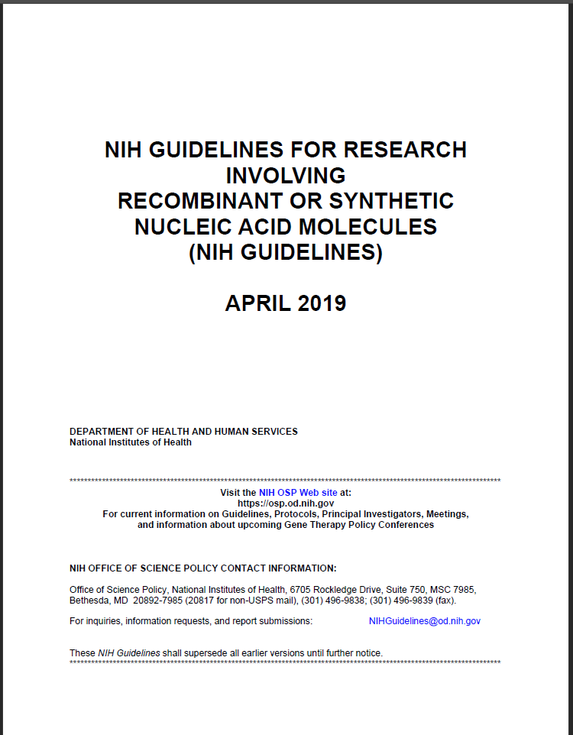
NIH Guidelines for Research Involving Recombinant or Synthetic Nucleic Acid Molecules
Evolving, scientifically-responsive document
Multiple revisions since 1976
Latest version – April 2019
https://osp.od.nih.gov/biotechnology/nih-guidelines/

Slide 3
Content of the NIH Guidelines
Section I – Scope
Section II – Safety Considerations
Section III – Types of Experiments Covered
Section IV – Roles and Responsibilities
Appendices
Notes:
The document is organized into 4 sections which describe the Scope of the Guidelines
Safety considerations for the conduct of research with recombinant and synthetic nucleic acid molecules
A description of the types of experiments covered
and the levels of review these experiments require.
And finally there is a section on the roles and
responsibilities of individuals and entities involved
in the conduct and oversight of research subject to the NIH Guidelines
And there are also a large number of appendices which cover particular topics in greater detail.

Slide 4
NIH Guidelines – Section I
Scope and Applicability
Specifies practices for constructing and handling
recombinant nucleic acid molecules,
synthetic nucleic acid molecules, including those that are chemically or otherwise modified but can base pair with naturally occurring nucleic acid molecules, and
cells, organisms and viruses containing such molecules.

Slide 5
NIH Guidelines – Section I
In the context of the NIH Guidelines, recombinant and synthetic nucleic acids are defined as:
(i) molecules that a) are constructed by joining nucleic acid molecules and b) can replicate in a living cell, i.e. recombinant nucleic acids;
(ii) nucleic acid molecules that are chemically or by other means synthesized or amplified, including those that are chemically or otherwise modified but can base pair with naturally occurring nucleic acid molecules, i.e. synthetic nucleic acids; or
(iii) molecules that result from the replication of those described in (i) or (ii) above.

Slide 6
The NIH Guidelines Apply to…
Research with recombinant or synthetic (or both) nucleic acid molecules that is
Performed at or sponsored by an institution that receives any NIH funding for such research
Rationale: For biosafety to be meaningful, it has to be observed by all investigators at an institution
Applicability broader than many NIH
grants and contracts requirements

Slide 7
Are the NIH Guidelines Optional?
“Guidelines” does not mean “optional”
They are a term and condition of NIH funding for research with recombinant or synthetic nucleic acid molecules

Slide 8
Are the NIH Guidelines Optional?
What are potential consequences of noncompliance with the NIH Guidelines?
Suspension, limitation, or termination of NIH funds for research subject to the NIH Guidelines at the institution, or
A requirement for prior NIH approval of any or all research subject to the NIH Guidelines at the institution.

Slide 9
Prescription versus Flexibility
Some matters are left to institutional discretion
Flexibility is a two-sided coin
Accommodates institutional diversity and heterogeneity
Can create uncertainty about expectations

Slide 10
Specifics vs. Intent
“The NIH Guidelines will never be complete or final since all conceivable experiments involving recombinant or synthetic nucleic acid molecules cannot be foreseen. Therefore, it is the responsibility of the institution and those associated with it to adhere to the intent of the NIH Guidelines as well as to the specifics.”
Good judgment is key
NIH OSP can help!

Slide 11
Section II - Safety Considerations

Slide 12
NIH Guidelines – Section II
Safety Considerations
Risk assessments: (Appendix B)
RG 1 RG 2 RG 3 RG 4
Agents that are not associated with disease in healthy adult humans | Agents that are associated with human disease which is rarely serious and for which preventive or therapeutic interventions are often available | Agents that are associated with serious or lethal human disease for which preventive or therapeutic interventions may be available (high individual risk but low community risk) | Agents that are likely to cause serious or lethal human disease for which preventive or therapeutic interventions are not usually available (high individual risk and high community risk)

Slide 13
NIH Guidelines – Section II
Safety Considerations
Containment
Physical (Appendix G)
Practices
Equipment
Facilities
Biological (Appendix I)
Survival
Transmission
BSL4
BSL3
BSL2
BSL1

Slide 14
Section III - Levels of Review
IBC, NIH OSP(consult with experts), NIH Director
IBC, NIH OSP (consult with experts)
IBC, IRB
RISK
IBC
IBC (notification)
Exempt

Slide 15
NIH Guidelines Section III - Levels of Review
Level of review | Example of types of research covered | Relevant section(s) of the NIH Guidelines
IBC and NIH Director review and approval | Experiments that compromise the control of disease agents in medicine through deliberate transfer of a drug resistance trait | III-A
IBC approval and NIH review for containment determinations | Experiment involving the cloning of toxin molecules with LD50 of less than 100 nanograms per kilogram of body weight | III-B
IBC and IRB approval and NIH review before research participant enrollment | Experiments involving the deliberate transfer of recombinant or synthetic nucleic acid molecules into a human research participant | III-C
IBC approval before initiation | Creating stable germline alterations of an animal’s genome, or testing viable recombinant or synthetically modified microorganisms on whole animals, where BL-2 containment or greater is necessary | III-D
IBC notice at initiation | Creating stable germline alterations of rodents by introduction of recombinant or synthetic nucleic acid molecules when these experiments require only BL-1 containment | III-E
Exempt from the NIH Guidelines. IBC registration not required if experiment not covered by Sections III-A, III-B, or III-C | Purchase or transfer of transgenic rodents | III-F

Slide 16
Section III-A
Experiments Require IBC Approval and NIH Director Approval Before Initiation
“Major Action”
The deliberate transfer of a drug resistance trait to microorganisms that are not known to acquire the trait naturally, if such acquisition could compromise the use of the drug to control disease agents in humans, veterinary medicine, or agriculture

Slide 17
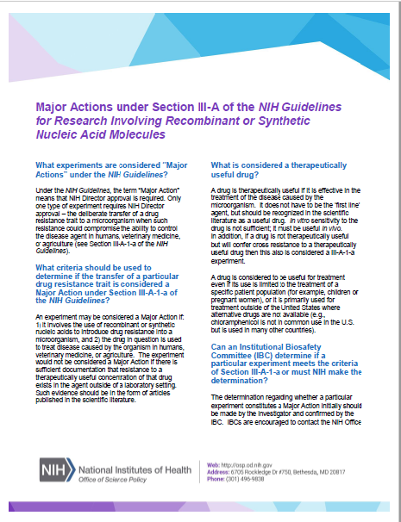
Section III-A

Slide 18
Section III-B
Experiments Require NIH OSP and IBC Approval Before Initiation
III-B-1: Experiments involving the cloning of toxin molecules with LD50 of less than 100 nanograms per kilogram body weight
III-B-2: Experiments that have been approved (under Section III-A-1-a) as Major Actions under the NIH Guidelines

Slide 19
Section III-C
Experiments Require IBC Approval and approval from all applicable institutional and regulatory authorities before initiation
Human gene transfer - deliberate transfer into human research participants of either:
Recombinant nucleic acid molecules, or DNA or RNA derived from recombinant nucleic acid molecules, or
Synthetic nucleic acid molecules, or DNA or RNA derived from synthetic nucleic acid molecules, that meet any one of the following criteria:

Slide 20
Section III-C
Contain more than 100 nucleotides; or
Possess biological properties that enable integration into the genome (e.g., cis elements involved in integration); or
Have the potential to replicate in a cell; or
Can be translated or transcribed.

Slide 21
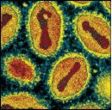
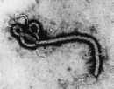
Section III-D-1
Experiments IBC Require Approval Before Initiation
Experiments Using Risk Group 2, Risk Group 3, Risk Group 4, or Restricted Agents as Host-Vector Systems

Slide 22
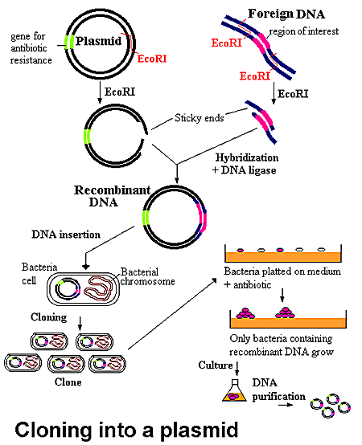
Section III-D-2
Experiments Require IBC Approval Before Initiation
Experiments in Which DNA From Risk Group 2, Risk Group 3, Risk Group 4, or Restricted Agents is Cloned into Nonpathogenic Prokaryotic or Lower Eukaryotic Host-Vector Systems

Slide 23
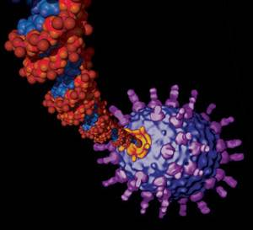
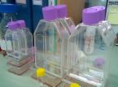
Section III-D-3
Experiments Require IBC Approval Before Initiation
Experiments Involving the Use of Infectious DNA or RNA Viruses or Defective DNA or RNA Viruses in the Presence of Helper Virus in Tissue Culture Systems

Slide 24
Section III-D-4: Experiments Involving Whole Animals
Includes experiments in which:
The animal’s genome has been altered by stable introduction of recombinant or synthetic nucleic acids into germline (transgenic animals)
Viable recombinant or synthetic nucleic acid molecule-modified microorganisms are tested on whole animals

Slide 25
Section III-D-5: Experiments Involving Whole Plants
Includes experiments in which:
Plants are genetically engineered by recombinant or synthetic nucleic acid molecule methods
Plants are used with recombinant or synthetic nucleic acid molecule containing insects
Generally BL2-P through BL4-P, depending on risk

Slide 26
Section III-D-6: Experiments Involving More Than 10L of Culture
Also See Appendix K

Slide 27
Section III-D-7
Experiments Involving Influenza Viruses
Generated by recombinant or synthetic methods (e.g., reverse genetics of chimeric viruses with reassorted segments, introduction of specific mutations) shall be conducted at the biosafety level containment corresponding to the risk group of the virus that was the source of the majority of segments in the recombinant virus
Experiments with influenza viruses containing genes or segments from 1918-1919 H1N1 (1918 H1N1), human H2N2 (1957-1968) and highly pathogenic avian influenza H5N1 strains within the Goose/Guangdong/96-like H5 lineage (HPAI H5N1) shall be conducted at BL3 enhanced containment

Slide 28
Section III-E
Experiments Require IBC Notice Simultaneous with Initiation
E-1 Experiments Involving the Formation of Recombinant or Synthetic Nucleic Acid Molecules Containing No More than Two-Thirds of the Genome of any Eukaryotic Virus
E-2 Experiments Involving Whole Plants
E-3 Experiments Involving Transgenic rodents
Also - Experiments not included in III-A through III-D or III-F that can be conducted at BSL1 (“catch all”)

Slide 29
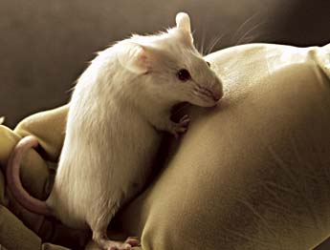
Section III-E-3
Experiments Involving the Generation of Transgenic Rodents
Experiments in which:
Rodent’s genome has been altered by stable introduction of recombinant or synthetic nucleic acid molecules into germline
BL1 containment is appropriate

Slide 30
Section III-F: Exempt Experiments
Registration with the Institutional Biosafety Committee is not required (although many institutions may require this by policy)

Slide 31
Section III-F-1: Exempt Experiments
Synthetic nucleic acids that:
can neither replicate nor generate nucleic acids that can replicate in any living cell (e.g., oligonucleotides or other synthetic nucleic acids that do not contain an origin of replication or contain elements known to interact with either DNA or RNA polymerase), and
are not designed to integrate into DNA, and
do not produce a toxin that is lethal for vertebrates at an LD50 of less than 100 nanograms per kilogram body weight.

Slide 32
Section III-F-1: Exempt Experiments
Note: If a synthetic nucleic acid is deliberately transferred into one or more human research participants and meets the amended criteria of Section III-C, it is not exempt under the NIH Guidelines.

Slide 33
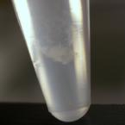
Section III-F-2
Exempts the following experiments:
Those that are not in organisms, cells or viruses and that have not been modified or manipulated (e.g., encapsulated into synthetic or natural vehicles) to render them capable of penetrating cellular membranes.

Slide 34
Section III-F-3
Those that consist entirely of recombinant or synthetic nucleic acid sequence from a single source that exists contemporaneously in nature

Slide 35
Section III-F-4
Those that consist entirely of nucleic acids from a prokaryotic host including its indigenous plasmids or viruses when propagated only in that host (or a closely related strain of the same species), or when transferred to another host by well established physiological means.

Slide 36
Section III-F-5
Those that consist entirely of nucleic acids from an eukaryotic host including its chloroplasts, mitochondria, or plasmids (but excluding viruses) when propagated only in that host (or a closely related strain of the same species).

Slide 37
Section III-F-6
Those that consist entirely of DNA segments from different species that exchange DNA by known physiological processes, though one or more of the segments may be a synthetic equivalent.
Meaning recombinant DNA molecules that are:
composed entirely of DNA segments from one or more of the organisms within a sublist, and
to be propagated in any of the organisms within the same sublist

Slide 38
Section III-F-7
Those genomic DNA molecules that have acquired a transposable element provided the transposable element does not contain any recombinant and/or synthetic DNA

Slide 39
Section III-F-8
Those that do not present a significant risk to health or the environment as determined by the NIH Director, with the advice of the RAC, and following appropriate notice and opportunity for public comment.
See Appendix C, Exemptions under Section III-F-8

Slide 40
Appendix C-I
Recombinant or Synthetic Nucleic Acid Molecules in Tissue Culture
Recombinant or synthetic nucleic acid molecules containing less than one-half of any eukaryotic viral genome (all viruses from a single family being considered identical) that are propagated and maintained in cells in tissue culture are exempt (with the exceptions listed in Appendix C-I-A)

Slide 41
Appendix C-II
Escherichia coli K-12 Host-Vector Systems
Experiments which use Escherichia coli K-12 host-vector systems (with the exception of those experiments listed in Appendix C-II-A) exempt.

Slide 42
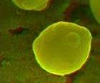
Appendix C-III
Saccharomyces Host-Vector Systems
Experiments involving S. cerevisiae and S. uvarum host-vector systems (with the exception of experiments listed in Appendix C-III-A) are exempt

Slide 43
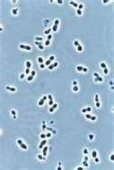
Appendix C-IV
Kluyveromyces Host-Vector Systems
Experiments involving K. lactis host-vector systems (with the exception of experiments listed in Appendix C-III-A) are exempt.

Slide 44
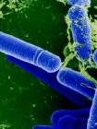
Appendix C-V
Bacillus subtilis or Bacillus licheniformis Host-Vector Systems
Any asporogenic Bacillus subtilis or asporogenic Bacillus licheniformis strain which does not revert to a spore-former with a frequency greater than 10⁷ may be used for cloning DNA (with the exception of those experiments listed in Appendix C-IV-A, Exceptions)

Slide 45
Appendix C-VI
Extrachromosomal Elements of Gram Positive Organisms
Recombinant or synthetic nucleic acid molecules derived entirely from extrachromosomal elements of the organisms listed below, propagated and maintained in organisms listed below are exempt.
Bacillus amyloliquefaciens
Bacillus amylosacchariticus
Bacillus anthracis
Bacillus aterrimus
Bacillus brevis
Bacillus cereus
Bacillus globigii
Bacillus licheniformis
Bacillus megaterium……. (see NIH Guidelines for complete list)

Slide 46
Appendix C-VII
The Purchase or Transfer of Transgenic Rodents
The purchase or transfer
of transgenic rodents for
experiments that require
BL1 containment
Further manipulations of these animals are not
necessarily exempt from the NIH Guidelines

Slide 47
Appendix C-VIII
Generation of BL1 Transgenic Rodents via Breeding
The breeding of two different transgenic rodents or the breeding of a transgenic rodent and a non-transgenic rodent with the intent of creating a new strain of transgenic rodent that can be housed at BL1 containment will be exempt from the NIH Guidelines if:
Both parental rodents can be housed under BL1 containment; and
Neither parental transgenic rodent contains the following genetic modifications: (i) incorporation of more than one-half of the genome of an exogenous eukaryotic virus from a single family of viruses; or (ii) incorporation of a transgene that is under the control of a gammaretroviral long terminal repeat (LTR); and
The transgenic rodent that results from this breeding is not expected to contain more than one-half of an exogenous viral genome from a single family of viruses.

Slide 48
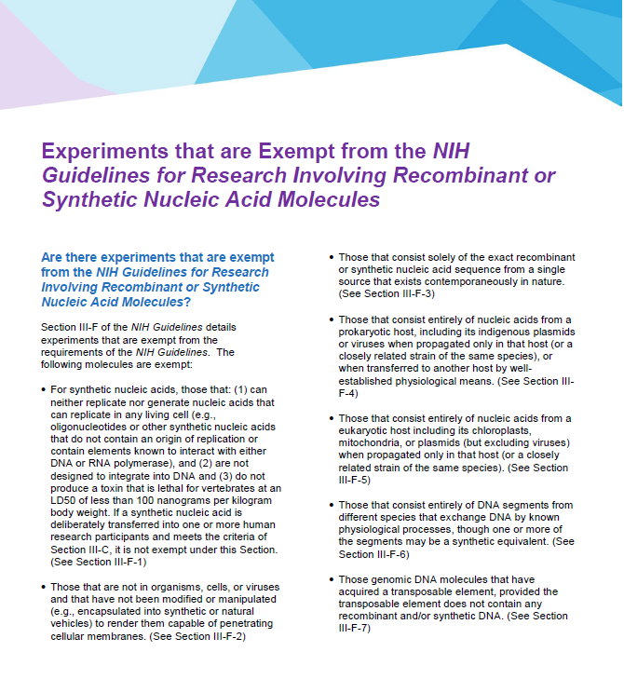
Section III-F (and Appendix C)

Slide 49
NIH Guidelines – Section IV
Roles and Responsibilities
Institution
Institutional Biosafety Committee (IBC)
Biological Safety Officer (BSO)
Principal Investigator (PI)
NIH

Slide 50
Institutional Responsibilities under the NIH Guidelines
The Institution shall:
Establish and implement policies for the safe conduct of research subject to the NIH Guidelines
Establish an Institutional Biosafety Committee
Assist and ensure compliance with the NIH Guidelines by investigators
Ensure appropriate training for IBC members and staff, PIs, laboratory staff
Determine necessity for health surveillance of personnel
Report any significant accidents, incidents or violations to NIH OSP within 30 days (or immediately as required)

Slide 51
PI Responsibilities under the NIH Guidelines
The Principal Investigator shall (among other things):
Initiate or modify no research subject to the NIH Guidelines which requires IBC approval until approval is granted
Determine whether experiments are covered under III-E and notify the IBC as appropriate
Be adequately trained in good microbiological techniques
Adhere to IBC emergency plans for spills and personnel contamination
Report any significant problems or violations to NIH OSP within 30 days (or immediately as required)

Slide 52
NIH Responsibilities under the NIH Guidelines
NIH OSP (on behalf of the NIH Director)
Conducting and supporting training of IBCs, BSOs, investigators, laboratory staff
Review of certain basic recombinant or synthetic nucleic acid molecule experiments
“Minor actions”
Changes not requiring approval by the NIH Director

Slide 53
NIH OSP Responsibilities under the NIH Guidelines
Basic experiments reviewed by NIH OSP
Deliberate transfer of drug resistance trait to microorganisms not known to acquire the trait naturally, if it could compromise disease control
Cloning of toxin molecules with LD₅₀ <100 ng/Kg bodyweight
Recombinant or synthetic nucleic acid molecules from restricted agents transferred to nonpathogenic prokaryotes or lower eukaryotes
Recombinant or synthetic nucleic acid molecules from nonpathogenic prokaryotes or lower eukaryotes transferred to restricted agents
Use of infectious or defective restricted poxviruses in presence of helper virus

Slide 54
NIH Guidelines - Appendices
Appendix A – Exemptions: Natural Exchangers
Appendix B – Classification of Etiologic Agents
Appendix C – Exemptions under III-F
Appendix D – Major Actions
Appendix E – Certified Host-Vector Systems
Appendix F – Biosynthesis of Toxic Molecules
Appendix G – Physical Containment
Appendix H – Shipment *
Appendix I – Biological Containment
* Use current DOT/IATA regulations

Slide 55
Organization of the NIH Guidelines
Appendix J – Biotechnology Research Subcommittee
Appendix K – Large Scale Physical Containment
Appendix L* – Physical and Biological Containment: Plants
Appendix M* – Physical and Biological Containment: Animals
*Renumbered from previous editions

Slide 56
Questions

