Slide 1
Safe Use of Autoclaves and Proper Waste Disposal
5/2/2019

Slide 2
Learning Objectives
The following online training course provides employees with autoclave information concerning processes, equipment, and operations that are conducted at East Carolina University.
Employees will be introduced to autoclaving procedures, types of autoclaves used at ECU, procedures to follow when operating an autoclave, and how to verify if the autoclave is properly decontaminating materials.
Additional autoclave information can be found in ECU’s Biosafety Manual located under Documents on Prospective Health’s website.

Slide 3
Introduction
North Carolina medical waste rules (15A NCAC 13 B .1200), require that "Regulated Medical Waste", defined as "blood and body fluids in individual containers greater than 20 ml, microbiological waste, and pathological waste,” must be treated before disposal in order to render the waste nonhazardous.
Most ECU campus laboratory‐generated biohazard waste falls under the State defined category of “microbiological waste” within 15A NCAC 13 B .1200.

Slide 4
Introduction
Biohazard waste generated and collected in ECU research laboratories is to be properly autoclaved according to procedures outlined in the following training.
Autoclaving in Biological Safety essentially means the process by which superheated steam is used to sterilize biohazard waste.
Autoclaving changes the biological character of the waste to reduce or eliminate its potential for causing disease.

Slide 5
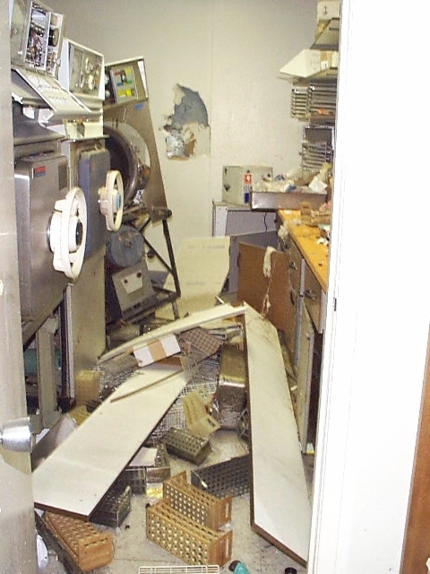
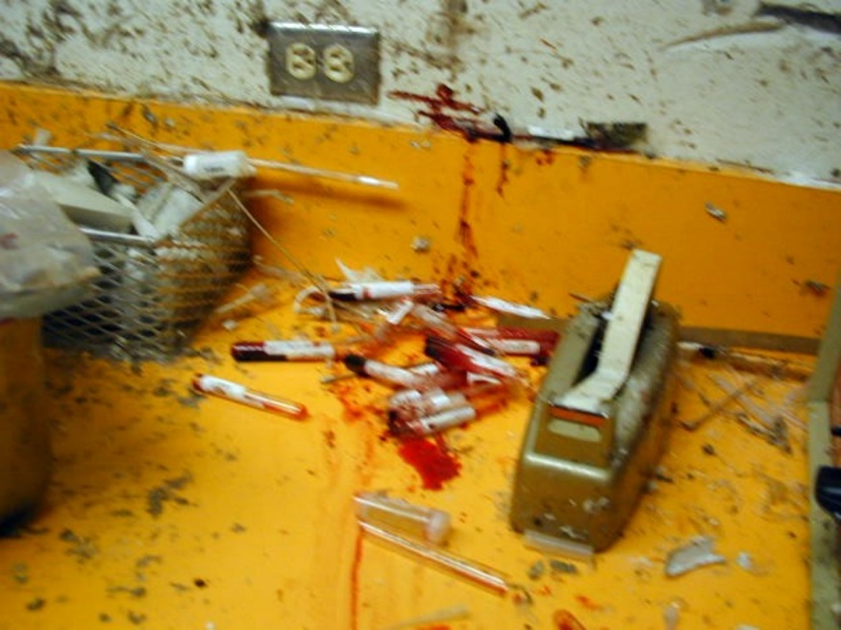
Why Do We Need to be Trained on Autoclave Use? Incidents can result in serious injury (see attached incident report from UNC-Chapel Hill) and OSHA recommends it under General Duty Clause, Section 5.

Slide 6
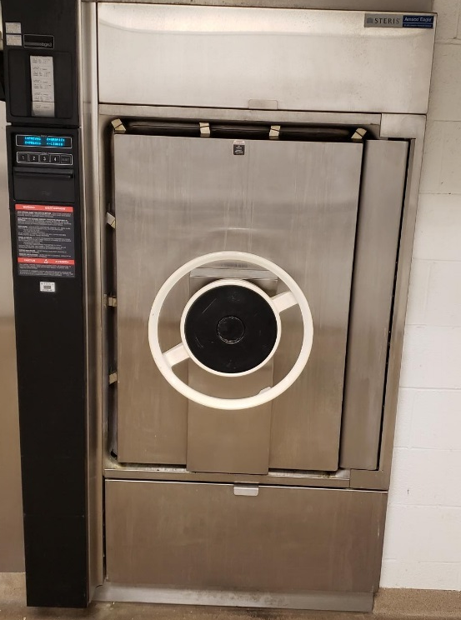
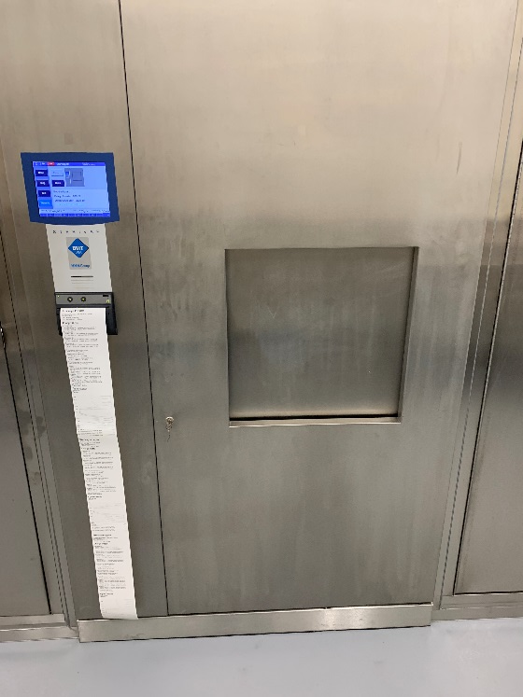
Types of Autoclaves
NOTE: Most autoclaves on ECU campus operate similarly in the context of mechanics, training is required in the use of each autoclave since not all autoclaves are programmed the same (different cycles), buttons/keypads are in different locations, doors open differently, etc.
Steris
Tuttnauer
Sterivap

Slide 7
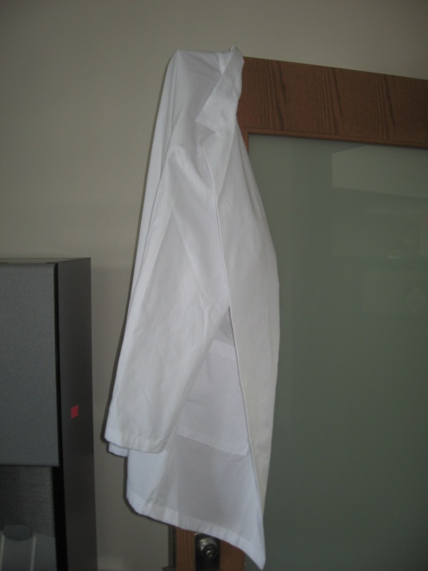
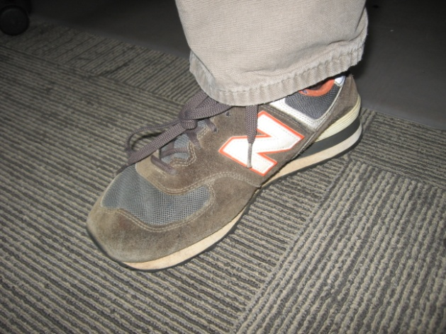
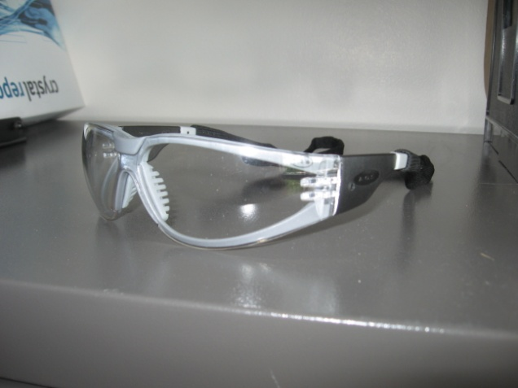
Personal Protective Equipment
Recommended PPE when placing material in an autoclave includes:
Eye Protection.
Lab Coat.
Closed Toed Shoes.
Latex Gloves.

Slide 8
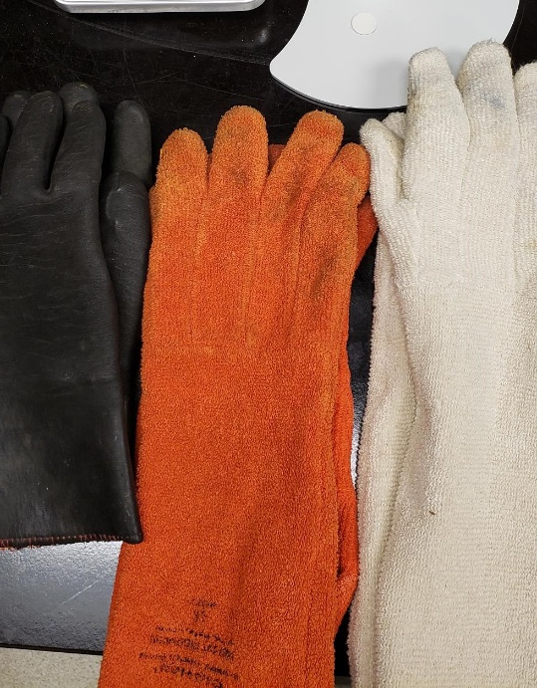
Personal Protective Equipment
Recommended PPE when removing material from an autoclave:
Eye Protection.
Heat Resistant Gloves.
Lab Coat.
Closed Toed Shoes.

Slide 9
What CAN be autoclaved?
Cultures & stocks of biological materials
Culture dishes & related devices
Discarded live and attenuated vaccines
Contaminated soiled items (pertri dishes, pipettes, gloves, paper towels)
Items for sterilization such as glassware, media, water, equipment
Infected small animal carcasses

Slide 10
What CANNOT be autoclaved
Materials containing solvents (such as chloroform), volatile or corrosive chemicals
Material contaminated with chemotherapeutic agents
Radioactive material
Heat sensitive material or equipment to be reused

Slide 11
Proper Autoclave Use
Importance of Use
Proper temperature and exposure time are critical in insuring the reliability of the autoclaving process.
These factors are dependant upon steam penetration to every part of the waste load.
Air is essentially an enemy of steam. If all the air is not allowed to escape from the waste during the autoclave cycle, then steam will not replace the air. Biohazard waste bags must get proper ventilation.
The autoclave user must be mindful to prevent the entrapment of air. (ie., Leaving the biowaste bag open inside the autoclave, removing the lid on sharps containers inside the autoclave.)

Slide 12
Proper Autoclave Use
Importance of Use (cont’d…)
Hazards Associated with Autoclaves:
Autoclaves present the potential of an explosion hazard due to the steam that builds up pressure within the autoclave chamber.
Hot temperatures and extremely hot water in the autoclave present burn and scald hazards to employees who load and unload materials from the autoclave.
Inadequate decontamination also presents a hazard as it allows for the potential of biological hazards to be released and contaminate employees as well as the environment.
Large heavy doors and loading carriages also present an ergonomic hazard to employees.

Slide 13
Proper Autoclave Use
Importance of Use (cont’d…)
Ways to prevent hazards associated with autoclave use:
Read the owners manual since manufacturer recommendations for different types of autoclaves may vary.
Make sure autoclave doors and gaskets are firmly locked into place before operating the autoclave.
These interlocking mechanisms helps to prevents a sudden release of high pressure steam.
If the autoclave does not have interlocking mechanisms, take additional precautions to ensure the door are closed.

Slide 14
Proper Autoclave Use
Importance of Use (cont’d…)
Ways to prevent hazards associated with autoclave use (cont’d…):
Older autoclaves may have little or no heat shielding around its exposed sides.
A warning sign stating “Hot Surfaces, Keep Away” should be placed on or next to the autoclave to remind people of the heat hazard.
Combustible materials should never be stacked or stored next to an autoclave.
Never autoclave toxic, volatile, or radioactive material.
Contact Biosafety and EH&S if you have biohazard waste that contains any of these materials.

Slide 15
Proper Autoclave Use
Importance of Use (cont’d…)
Ways to prevent hazards associated with autoclave use (cont’d…):
When an autoclave cycle is complete, wait until the pressure gauge reads zero before opening the autoclave door.
Wait at least 30 seconds after opening the autoclave door before reaching or looking into the autoclave.
When opening the autoclave door, make sure to keep head, face, and hands away from the opening.
Always allow contents to cool before removing them from the autoclave.
Serious burns/scalding may occur if employee immediately removes materials.

Slide 16
Proper Autoclave Use
Ways to prevent hazards associated with autoclave use (cont’d…):
Solutions should be removed from the autoclave slowly and gently.
Some solutions have the potential to boil over when moved or exposed to room temperature.
Heat-resistant gloves, safety goggles or faceshield, and lab coat must be worn when removing hot liquids from the autoclave.
**If handling without heat-resistant gloves, liquids should stand for over 1 hour before handling.
Clean up spills immediately.
Report malfunctions or accidents to your supervisor immediately.

Slide 17
Autoclave Waste Decontamination Procedures
Autoclaves are to be operated at 121°C (250°F) or higher for a minimum of 30 minutes for waste decontamination.
***Please note run time may vary depending on type of biohazard and load size.

Slide 18
Autoclave Waste Decontamination Procedures
Material | Temperature | Time
Laundry | 121°C (250° F) | 30 Minutes
Trash (Biohazard bags containing infectious waste.) | 121°C (250° F) | 30 Minutes minimum
Glassware | 121°C (250° F) | 15 minutes
Liquids | 121°C (250° F) | 30 minutes minimum
Animals | 121°C (250° F) | 1 Hour

Slide 19
Autoclave Waste Decontamination Procedures
Autoclaving Liquid Materials:
The autoclave may have a ‘LIQUID’ setting that can be used for liquid materials. The settings for liquids runs for a longer period at a lower temperature to minimize liquid evaporation and spills.
Liquids should be placed in borosilicate (Kimax or Pyrex) or polypropylene containers for autoclaving and these containers should be filled to no more than 75% capacity.

Slide 20
Autoclave Waste Decontamination Procedures
Autoclaving Liquid Materials (cont’d…):
The caps/stoppers on the containers should be loosened.
Never autoclave sealed containers of liquid as this could result in an explosion of superheated liquid.
Liquid containers should be placed in a stainless steel or polypropylene tray with ¼ to ½ inch of water in the bottom on the tray.
This tray should be placed on a shelf in the autoclave, but not on the bottom of the chamber.

Slide 21
Autoclave Waste Decontamination Procedures
Autoclaving Solid Materials :
Never overfill (>75%) biohazard waste bags or the autoclave.
Overfilling either of these will interfere with steam penetration.
Biohazard waste bags should be kept slightly open to allow for proper steam penetration.

Slide 22
Autoclave Waste Decontamination Procedures
Autoclaving Solid Materials (cont’d…):
Biohazard waste bags are to be placed into a stainless steel or polypropylene tray prior to autoclaving.
Between 50-100 ml (¼ – ½ cup) of water should be added to each bag of solid waste to promote steam penetration within the bag.
Note: If there is naturally occurring water in the load, adding additional water is not necessary.

Slide 23
Autoclave Waste Decon Cycle Testing & Verification
N.C. Medical Waste Rules require that:
Autoclaves be monitored under conditions of full loading for effectiveness weekly through the use of biological indicators or other methods approved by the Division.
Autoclaves are to be provided with a chart recorder that accurately records time and temperature for each cycle.
Departments are responsible for ensuring their autoclaves are being tested at least weekly with a chemical indicator such as a Sterigauge card, and quarterly with a biological indicator.
***ECU policy states that research autoclaves should be tested with biological indictors quarterly.***

Slide 24
Autoclave Waste Decon Cycle Testing & Verification
Each department must:
Ensure personnel are trained to use autoclaves.
Verify run cycles at least weekly with a chemical indicator such as a Sterigauge card.
Verify run cycles quarterly with a biological indicator (see next slide).
Keep records of testing.
Follow the manual’s instructions for maintenance and repair.
***ECU policy states that research autoclaves should be tested with biological indictors quarterly.***

Slide 25
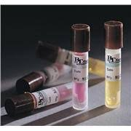
Autoclave Waste Decon Cycle Testing & Verification
Use of a Biological Indicator:
Geobacillus stearothermophilus indicators must be used that have average spore populations of 10⁴ to 10⁶ organisms.
There are many commercially available biological indicators with a choice of spore ampoules or spore strips with growth media.
***For autoclaves used for deconning/sterilizing materials for animal research, the Department of Comparative Medicine (DCM) offers to provide the vials and read test results. Arrangements can be made by calling the DCM research technician at 744-2452.

Slide 26
Autoclave Waste Decon Cycle Testing & Verification
Use of a Biological Indicator (cont’d…):
Follow the instructions provided by the manufacturer of the biological indicators. (Most require refrigeration when kept in storage.)
The indicator should be placed in the middle of the waste bag/material that is to be autoclaved.
A best practice is to put the indicator in the waste bag before the bag is filled completely.
Indicator recovery:
To aid in recovery, tape the indicator to a bright colored sheet of paper, OR
Tie it to a long piece of string that can hang out of the bag so that it can be retrieved after the autoclaving cycle has completed.

Slide 27
Autoclave Waste Decon Cycle Testing & Verification
Use of a Biological Indicator (cont’d…)
Autoclaving waste with biological indicator:
The biohazard waste can be autoclaved following normal procedures.
Once the cycle has completed and the contents have cooled, don all proper PPE and remove the indicator from the waste bag.
Follow the biological indicator manufacturer’s instructions to get results.

Slide 28
Autoclave Waste Decon Cycle Testing & Verification
Use of a Biological Indicator (cont’d…)
If growth is discovered on the autoclaved indicator:
The autoclave process needs to be re-evaluated:
Time, temperature, and autoclaving procedures should be reviewed.
If a mechanical problem is determined to be the culprit, the manufacturer or contractor (such as Sterilelink) should be contacted immediately for repair.

Slide 29
Autoclave Waste Decon Cycle Testing & Verification
Use of a Biological Indicator (cont’d…)
The waste does not have to be held until the results of the testing confirm effectiveness.
However, if test results show the autoclave is not sterilizing properly, the autoclave should not be used for waste until it is repaired.
Once repaired, the first load run in the autoclave should be tested with a biological indicator to insure that the autoclave is functioning properly.

Slide 30
Autoclave Waste Decon Cycle Testing & Verification
Autoclave Testing Results:
Autoclave Testing Log:
A log of each test should be maintained that includes the following information:
The type of indicator used.
Date the test was conducted.
Time the test was conducted.
Result of the test.

Slide 31
Autoclave Waste Decon Cycle Testing & Verification
Autoclave Testing Results (cont’d…):
Autoclaved waste is not required to be held until the results of the testing confirms effectiveness.
However, the autoclave should be shut down if test results indicate that the autoclave is not sterilizing the material properly.
All repairs should be performed that will render the autoclave operable and ensure that it is sterilizing the material appropriately.
After repairs are made, the first load run through the autoclave should be tested with a biological indicator to ensure the autoclave is operating effectively.

Slide 32
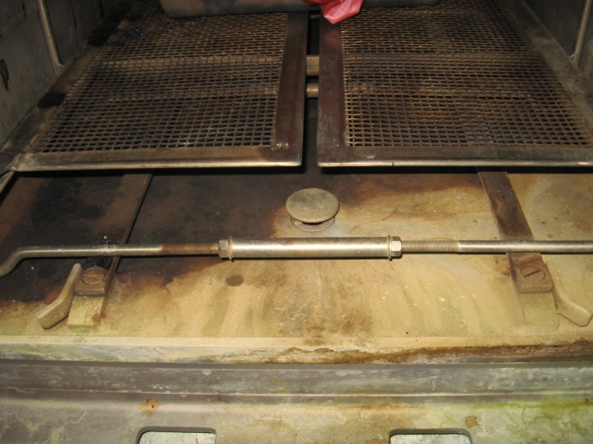
Preventative Maintenance
Plug Screen/Drainer:
In order to maintain the autoclaves effectiveness and for the autoclave to run properly, preventative maintenance should be conducted such as:
The plug screen or drainer should be removed, checked, and cleaned frequently to make sure it is free of dirt, dust, or sediment that may collect in it and cause a clog.
Plug screen/drainer location.
Plug screen/drainer.

Slide 33
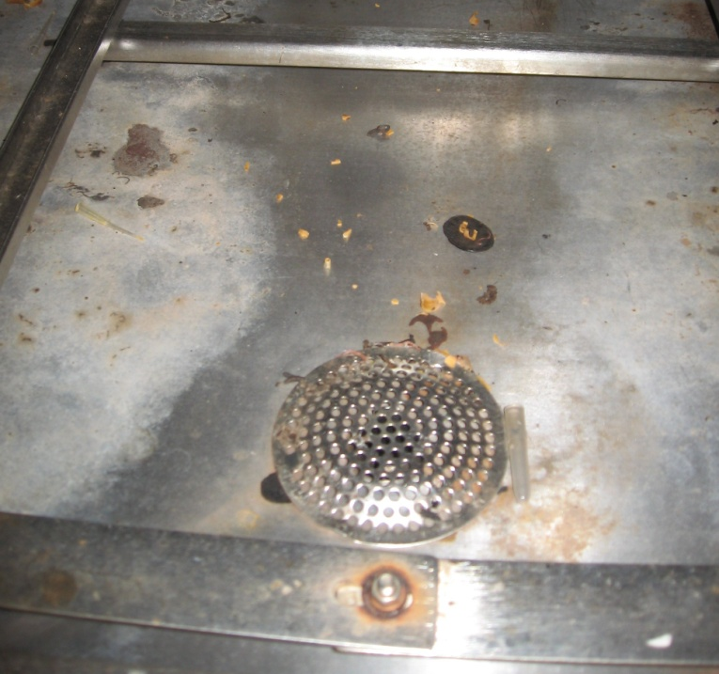
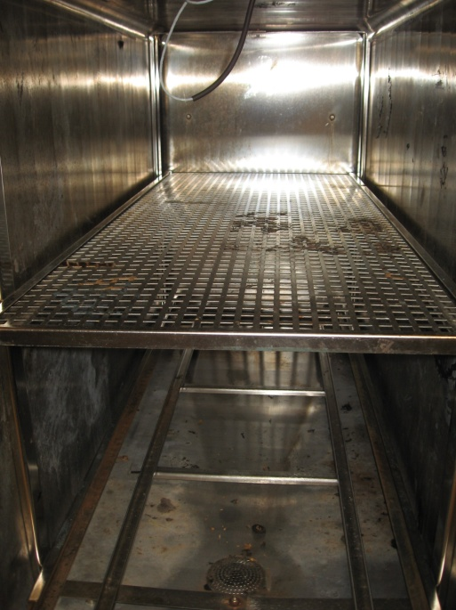
Preventative Maintenance
Surfaces:
The interior surfaces should be cleaned of any residues that collect from the steam or materials being sterilized.
Interior of autoclave.
Debris around drain inside autoclave.

Slide 34
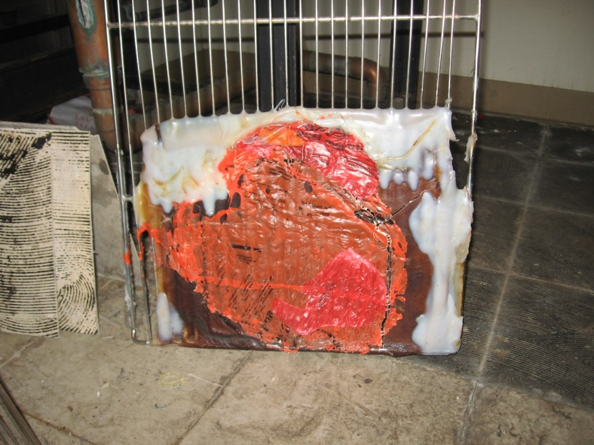
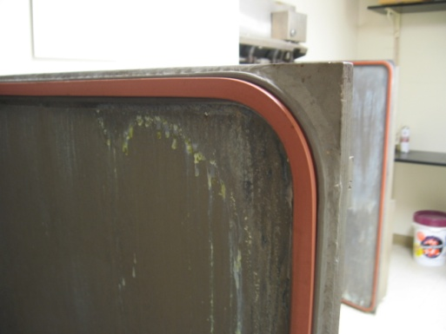
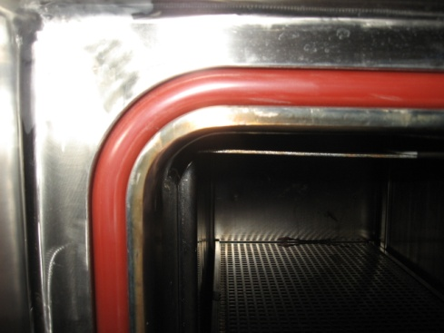
Preventative Maintenance
Surfaces (cont’d…):
On a regular basis gaskets, doors, shelves, and walls should be visually inspected for residue buildup and wear.
**NOTE If any problems are experienced with the autoclave contact Facilities Services immediately upon discovering the problem.
Gasket Around Door
Gasket Around Autoclave Jacket
Melted plastic on a shelf from an unautoclavable container.

Slide 35
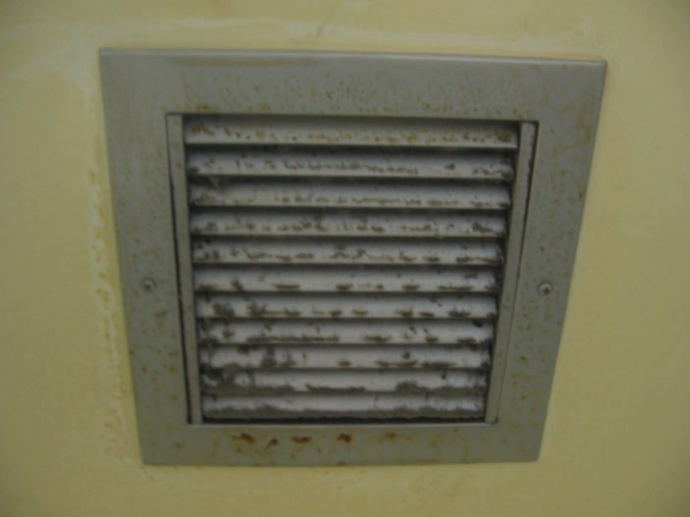
Preventative Maintenance
Air Filters:
Some autoclaves may have an air filter in the exhaust that is located directly above them and designed to pull out steam when the autoclave is opened.
Check the filter from time to time to ensure that it is not clogged and contact the appropriate personnel to replace the filter and clean off the debris that collects on the filter cover.

Slide 36
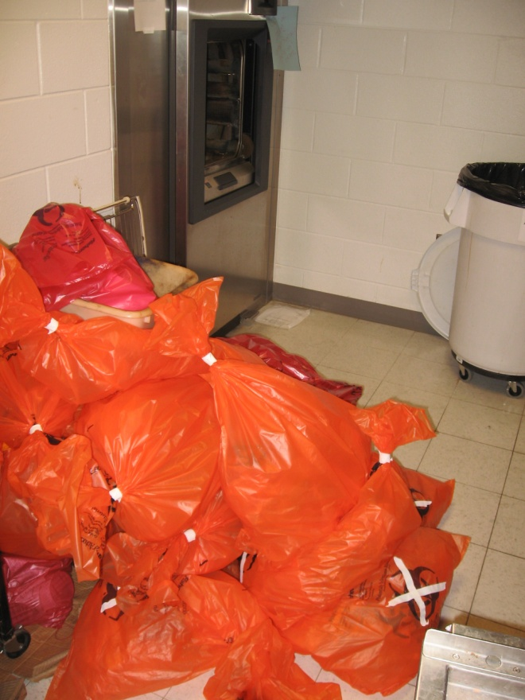
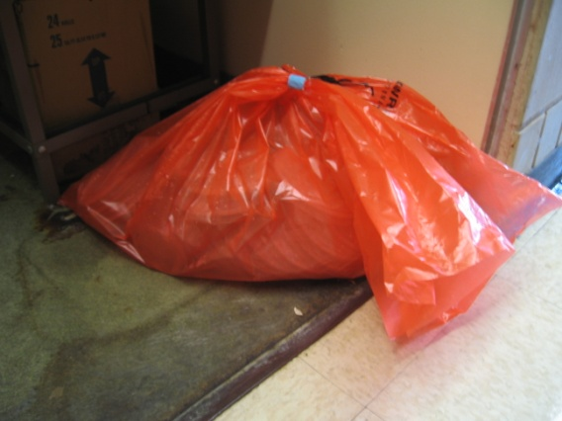
Proper Disposal of Biohazard Waste
All waste to be autoclaved must be placed in orange bags, red bags are for incineration only and are NOT autoclavable.
Dry waste should be separated from liquid waste.
Placement of biohazard materials before being autoclaved:
Contaminated materials are not to be left in hallways or other public spaces prior to autoclave decontamination.
Biohazard materials are required to be kept in the laboratory until they are autoclaved.
Biohazard material should never be left beside the autoclave or on the floor.
Animal carcasses must be placed in cold rooms or freezers.
Un-autoclaved bio-hazardous bags left on the floor beside an autoclave.

Slide 37
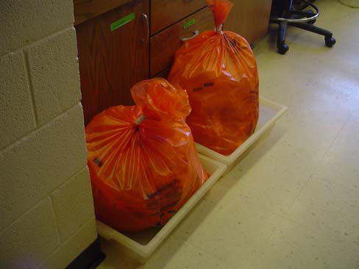
Proper Disposal of Biohazard Waste
Biohazard Bags:
Close the biohazard bag when 3/4 full using lab tape. Be sure to allow proper ventilation.
When a biohazard bag is closed and ready for autoclaving, it should be placed within secondary containment.
Waste material that is to be decontaminated at a site away from the laboratory is to be transported in closed, hard-walled secondary containers.
Bio-hazardous waste being stored in secondary containment.

Slide 38
Proper Disposal of Biohazard Waste
Biohazard Bags (cont’d…):
Contact with biohazard waste should be kept to a minimum as much as possible.
A cart may be used to transport the waste from the laboratory to the autoclave.
Biohazard waste should never be crushed or pushed down to create more space for materials in the bag.
Biohazard waste containers should be removed for autoclaving when they are 2/3 full.
If outside bag is contaminated double bag in another orange bag.

Slide 39
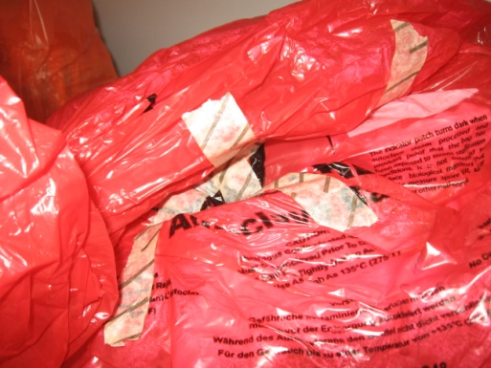
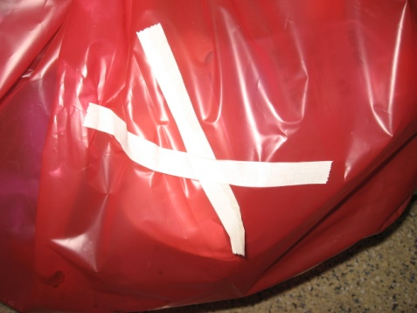
Proper Disposal of Biohazard Waste
Biohazard Bags (cont’d…):
Indicator Tape (Heat Sensitive Tape):
Indicator tape should be applied when placing the new autoclave bag inside the hard-walled outer container as it will aid in reducing the handling of the biohazard waste during removal.
The indicator tape should be visible on the bag.
The indicator tape is to be of the type that changes color. (ie The word ‘Autoclaved’ appears on the tape after treatment.)
Indicator tape is available through Fisher Scientific (www.fishersci.com) as #15-903.
Autoclaved
(markings on tape)
Not autoclaved
(no markings on tape)

Slide 40
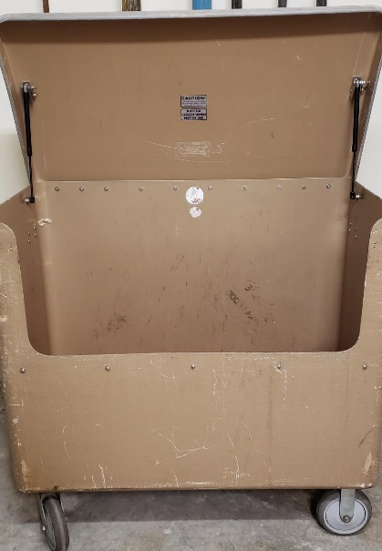
Proper Disposal of Biohazard Waste
Biohazard Bags (cont’d…):
Once the biohazard material has been autoclaved, the top of the bag can be sealed tightly with lab tape.
Decontaminated waste is then to be placed in a designated waste collection site in a waste collection bin such as:

Slide 41
Proper Disposal of Biohazard Waste
Autoclaved waste is picked up by the Office of Prospective Health’s waste technicians at regular intervals, and is picked up by a vendor such as Stericycle for incineration offsite.
Waste pickup can also be scheduled by calling the Prospective Health Wasteline at 744-3867 and press 3.

Slide 42
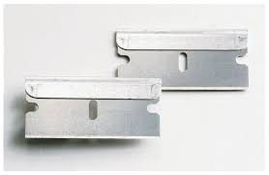
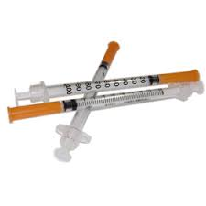
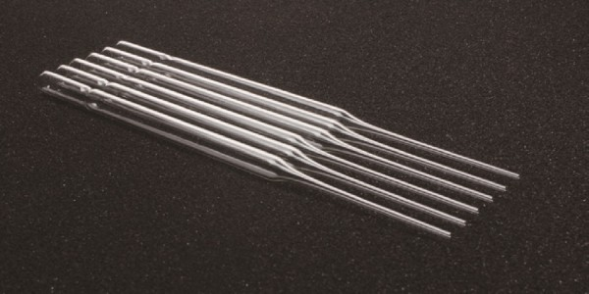
Proper Disposal of Biohazard Waste
Sharps:
Contaminated sharps items include:
Razor blades.
Scapels.
Lancets.
Syringes with or without needles.
Slide covers.
Specimen tubes.
Microscope slides
Pasteur pipets

Slide 43
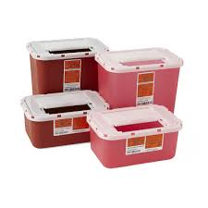
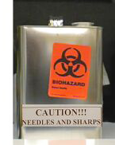
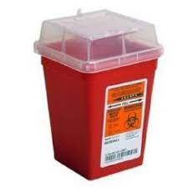
Proper Disposal of Biohazard Waste
Sharps Containers:
When sharps containers are 2/3 full they must be sealed and placed in the designated biohazard waste collection area.
They are then picked up along with other biohazardous waste by Office of Prospective Health’s waste technicians.

Slide 44
Proper Disposal of Biohazard Waste
Sharps Containers (cont’d…):
Accident Prevention:
To avoid accidents related to overfilling cans, the can should be removed for decontamination or disposal when it is 2/3 full.
Federal OSHA regulation 1910.1030 require biohazard laboratories to minimize their use of sharps whenever possible.
Needles are not to be:
Recapped.
Purposely bent.
Broken.
Manipulated by hand.

Slide 45
Proper Disposal of Biohazard Waste
Sharps Containers (cont’d…):
Contaminated Broken Glass:
Small shards can be placed into sharps containers.
Large glass items must be:
Autoclaved separately in a hard-walled container (ie cardboard box) that is lined with a biohazard bag that is marked with autoclave indicator tape.
Once autoclaved it should then be disposed of in a cardboard box lined with a plastic bag and clearly marked with the “GLASS AND SHARPS” label.

Slide 46
Proper Disposal of Biohazard Waste
Research Lab/Clinic Pipetting:
For large‐scale collection of Glass (Pasteur) and plastic pipettes contaminated under the definition of biohazard waste, line a puncture resistant outer container (ie package the pipettes came in) with an orange autoclave bag bearing the biohazard symbol that is marked out with an “X” using autoclave indicator tape.
Autoclave Indicator Tape can be purchased through Fisher Scientific under item #11‐889‐11

Slide 47
Proper Disposal of Biohazard Waste
Research Lab/Clinic Pipetting (cont’d…):
To avoid handling a bag full of pipettes, place the indicator tape over the bag’s biohazard symbol prior to loading the bag with pipettes.
The universal biological hazard symbol must be displayed on the inner and outer container.
The outer container may also be contaminated so it too should be autoclaved.
This helps to reduce handling of the pipettes which tend to puncture the bag during treatment handling.

Slide 48
Proper Disposal of Biohazard Waste
Research Lab/Clinic Pipetting (cont’d…):
Pipette tips:
Are to be collected on the benchtop in a small autoclave bag lining a wire stand or other container bearing the biohazard symbol.
The bag should be loosely closed to allow for steam penetration.
Once autoclaved, the bag can then be placed with other solid biohazard waste.

Slide 49
Proper Disposal of Biohazard Waste
Contaminated Solids:
Biohazard solids include the following:
Culture dishes & flasks.
Petri dishes.
Solid waste cultures/stocks from the testing and production of biologicals.
Gloves, gowns, & masks.
Other solid material potentially contaminated under the definition of biohazard waste.

Slide 50
Proper Disposal of Biohazard Waste
Contaminated Solids (cont’d…):
The outer collection container for contaminated solid biohazard waste must be:
Durable.
Leak proof.
Have a lid and be of such a design so that it cannot be mistaken by Housekeeping as regular trash.
This container must be labeled with a biohazard sticker.
**IMPORTANT Wire cages cannot be used as an outer container.

Slide 51
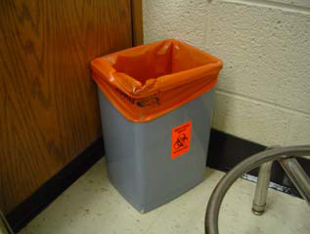
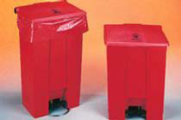
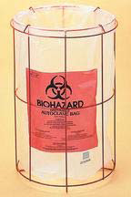
Proper Disposal of Biohazard Waste
Contaminated Solids (cont’d…)
Examples of what containers to use and not to use for contaminated solid biohazard waste:
YES: Proper red container with proper biohazard sign.
NO: Proper signage, but no lid.
NO: Proper container but no biohazard sign.
NO: Using the wrong container. No ‘wire’ containers can be used.

Slide 52
Proper Disposal of Biohazard Waste
Contaminated Liquids
Rules and definitions for liquid biohazard waste vary somewhat from those for solid waste procedures, but autoclaving is still the method of choice for the following materials:
Liquid human blood.
Animal blood/body fluids from animals infected with BSL2 and BSL3 agents.
Human tissue culture, human cell lines (primary or established).
Human body fluids as defined under the ECU Laboratory Exposure Control Plan.
Liquid growth media removed from human tissue cultures.
**Note: AUTOCLAVED liquid waste may be discharged into the sanitary sewer.

